Slide 1
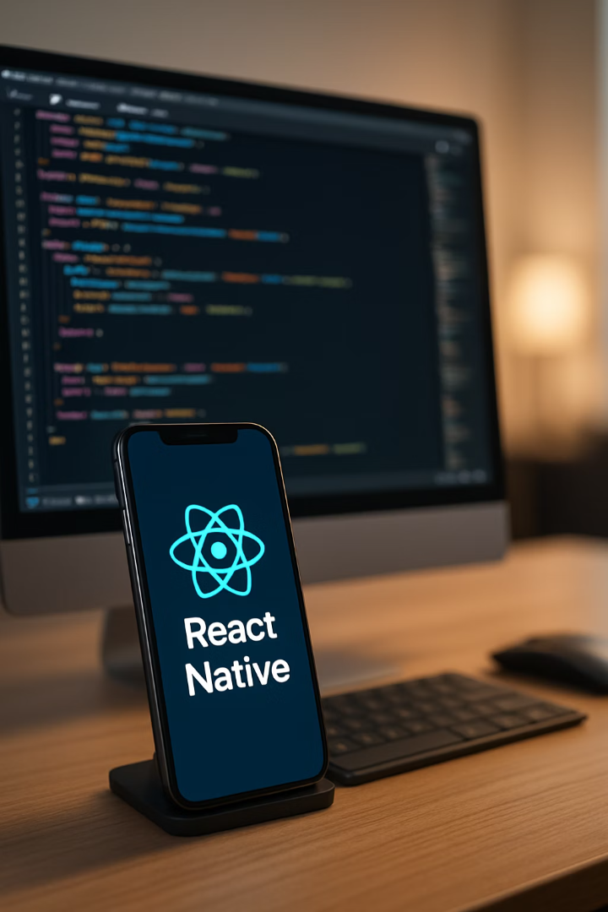
Updating and Publishing Your React Native App
Welcome to this comprehensive guide on handling updates and exploring publishing platforms for your React Native applications. Whether you're making improvements to an existing app or preparing to release your creation to the world, this presentation will walk you through the essential processes, best practices, and alternative distribution channels beyond the Google Play Store.
By the end of this presentation, you'll have a clear understanding of how to update your React Native app, efficiently deploy changes to Android devices, and explore various platforms where you can publish your application to reach your target audience.

Slide 2






Understanding the React Native Update Process
Make Code Changes
Implement necessary updates to your React Native project
Update Version Information
Increment version code and name in app.json or app.config.js
Build New APK/AAB
Create updated package using the same process as original build
Install & Verify
Deploy the updated package and confirm changes are reflected
To update your React Native app, you need to create a new APK or AAB (Android App Bundle) and install it on your device. This process ensures that all your latest changes are properly reflected in the installed application.

Slide 3
Making and Preparing Code Changes
1
Implement Required Updates
2
Update Documentation
Carefully review requirements and make all necessary changes to your React Native codebase. Test each feature thoroughly to ensure functionality.
Keep your code comments and project documentation up-to-date to reflect the changes you've made for future reference.
3
Run Tests
4
Prepare for Deployment
Execute unit and integration tests to verify that your changes work as expected and haven't introduced new bugs.
Organize your changes in a structured way that makes the deployment process smoother and more predictable.
The first critical step in updating your React Native app is making all necessary code changes. Ensure your modifications are thoroughly tested before proceeding to the build phase to minimize issues in the released update.

Slide 4
Managing Version Information
Version Code
Version Name
Where to Update
An integer value that increases with each update. This is used by Android to determine if one version is more recent than another.
A string value visible to users that follows semantic versioning conventions (e.g., 1.2.3).
Update version information in app.json, app.config.js, or AndroidManifest.xml before building.
Communicates update significance
Expo: app.json or app.config.js
Must be incremented for each new release
Displayed in app stores
React Native CLI: AndroidManifest.xml
Helps with user communication
Not visible to users
Consistency is key across files
Critical for update recognition
Updating version information is optional but highly recommended for proper version management. It helps Android recognize your app as a newer version and ensures the update process goes smoothly. Failure to increment the version code may prevent installation of the update.

Slide 5
Building the Updated APK or AAB
Execute Build Command
Configure Build Settings
Run the appropriate build command for your setup. For Expo, use EAS Build, or for React Native CLI, use the gradle commands to generate your updated APK or AAB file.
Prepare Build Environment
Adjust any necessary build configurations in your gradle files. This may include updating signing configurations, enabling ProGuard rules, or setting up product flavors.
Ensure all dependencies are installed and environment variables are properly set. Check that your development environment meets all requirements for building an Android package.
Building the updated APK or AAB follows the same process you used for the original build, but now includes your recent changes. The build process compiles your JavaScript code along with native components into a package that can be installed on Android devices.

Slide 6

Installing the Updated APK
Download the APK
Access the APK from the EAS dashboard or CLI output after the build completes.
Enable Installation from Unknown Sources
On your Android device, ensure that installation from unknown sources is allowed in the security settings.
Open the APK File
Tap on the downloaded APK file to begin the installation process.
Confirm Installation
Accept any prompts to install the application and wait for the process to complete.
Once the build is complete, you'll need to install the updated APK on your Android device. This can be done directly by downloading and opening the APK file on your device, or by using ADB (Android Debug Bridge) for more control over the installation process.

Slide 7








Understanding Manual APK Installation Behavior
No Duplication
Version Update
Android recognizes the update based on the package name and replaces the existing version rather than creating a duplicate.
The app will be updated with new features and changes reflected in the installed version.
Data Preservation
Security Checks
Existing app data like preferences and saved information remains intact unless explicitly programmed otherwise.
Android verifies signature consistency, ensuring the update comes from the same developer as the original app.
When you manually install an APK update on your Android device, the system handles several processes automatically. Understanding these behaviors helps ensure a smooth update experience for both developers and users.

Slide 8
Using ADB for App Installation
# Install APK using ADB adb install -r path/to/your/app.apk # Install app bundle (AAB converted to APK set) adb install-multiple --apex path/to/extracted/apks/*.apk # Check installed package adb shell pm list packages | grep yourpackagename # Uninstall app if needed adb uninstall com.yourcompany.appname
ADB (Android Debug Bridge) is a powerful command-line tool that enables communication between your development environment and an Android device. It allows for more controlled installation and debugging of applications during the development process.
Using ADB for installation provides additional options like forcing installation over existing versions with the "-r" flag or targeting specific devices when multiple are connected. This approach is particularly useful for developers who need precise control over the update process or are troubleshooting installation issues.

Slide 9




Verifying Updates and Best Practices
Comprehensive Testing
Version Tracking
Changelogs
Beta Testing
Maintain detailed changelogs to track what changes were made in each version, helping with debugging and user communication.
Consider distributing updates to a small group of users first to catch issues before widespread release.
Thoroughly test all features and UI elements after installation to ensure updates function as expected across different device configurations.
Always increment version codes before building to ensure smooth updates and maintain clear version history for troubleshooting.
After installing the new APK, it's crucial to verify that all your latest changes are reflected properly. This verification step ensures that the update process has been successful and that users will experience the improvements you've made.

Slide 10
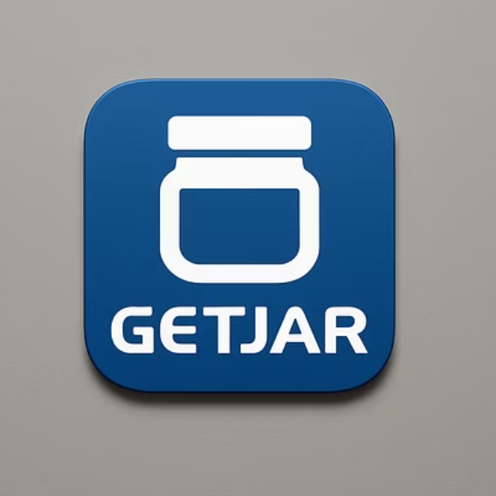
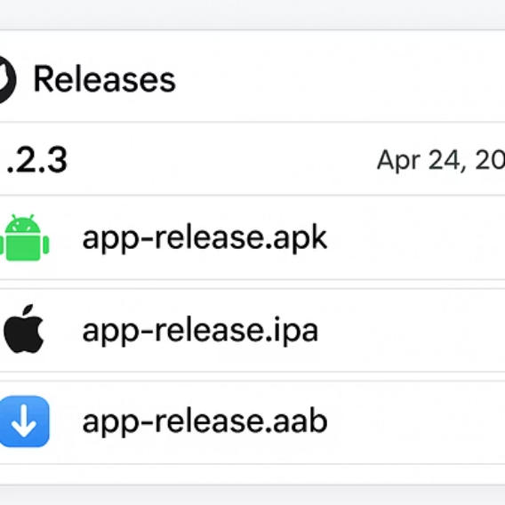
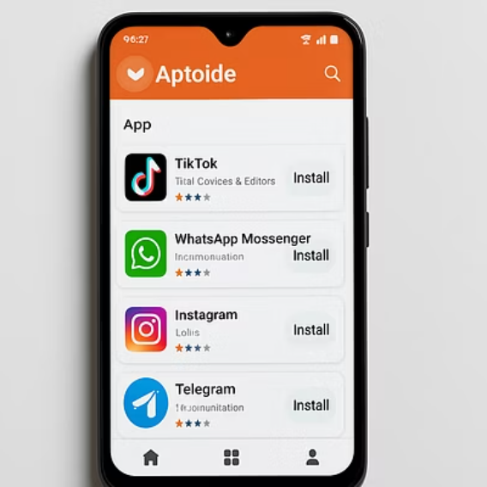
Introduction to Alternative Publishing Platforms
While Google Play Store is the most popular distribution platform for Android apps, there are several alternative platforms where you can publish your React Native application. These alternatives offer different advantages and may be more suitable depending on your specific needs and target audience.
Each platform has its own submission process, guidelines, and audience reach. Understanding these alternatives gives you more flexibility in how you distribute your app and can help you reach users who may not use the Google Play Store.
In the following slides, we'll explore three popular alternatives: GetJar, GitHub Releases, and Aptoide. Each offers unique benefits and considerations that may make them appropriate for your React Native app distribution strategy.

Slide 11





GetJar: Independent App Distribution
Established Platform
Monetization Options
One of the older independent app stores with a significant user base seeking alternatives to Google Play.
Offers both free and premium app distribution with various revenue models to choose from.
Cross-Platform
Global Reach
Supports multiple mobile platforms, making it suitable for React Native apps targeting different operating systems.
Provides access to international markets with users who specifically seek alternatives to mainstream app stores.
GetJar is a well-established platform for distributing Android apps that focuses on users who prefer alternatives to the Google Play Store. It offers a significant audience reach and flexible monetization options for developers looking to distribute their React Native applications.

Slide 12



GitHub Releases: Developer-Focused Distribution
Create a GitHub repository
Host your app's source code or just the releases
Create a new release
Tag versions and write changelogs
Upload APK files
Attach built packages to each release
While not a traditional app store, GitHub Releases offers a straightforward way to distribute your React Native APK directly to users. This approach gives you complete control over the distribution process and is particularly useful for beta testing or distributing to a specific audience like testers, contributors, or technical users.
GitHub Releases lets you maintain a version history, provide detailed release notes, and collect feedback through GitHub's issue tracking system. However, users must manually download and install the APK, which requires enabling installation from unknown sources on their devices.

Slide 13
Aptoide: Open Source App Store Platform
Decentralized Model
Key Features
Financial Model
Aptoide operates on a decentralized app store model where developers can create their own store within the platform. This gives you more control over how your app is presented and distributed.
Create your own branded store within the platform
There is no upfront cost to publish on Aptoide, making it accessible for independent developers and small studios. For paid apps, Aptoide offers revenue sharing options that can provide an alternative monetization channel.
No registration required for users to download apps
Support for in-app purchases and premium apps
The platform supports a wide range of applications including React Native apps and allows both free and paid distribution models.
Built-in social features for user engagement
The platform also supports various advertising models to help developers generate revenue from free applications.
Analytics and reporting tools for developers

Slide 14
Comparing Distribution Platforms
Feature
Google Play
GetJar
GitHub Releases
Aptoide
Registration Fee
$25 one-time
Free
Free*
Free
Revenue Share
30%
Varies
0%
Varies
User Reach
Very High
Medium
Low
Medium
Review Process
Strict
Moderate
None
Minimal
Update Control
Moderate
High
Complete
High
Analytics
Comprehensive
Basic
Basic
Moderate
* GitHub requires paid plans for private repositories, but public repositories with releases are free.
When choosing a distribution platform for your React Native app, consider factors like target audience, monetization goals, update frequency, and how much control you want over the distribution process. Many developers use multiple platforms to maximize reach and leverage the unique advantages of each.

Slide 15






Key Takeaways and Next Steps
Master your distribution strategy
Select platforms that best match your users' needs
Streamline your update process
Create efficient workflows for building and releasing
Understand the technical foundations
Know how APK updates and installations work
Throughout this presentation, we've covered the essential aspects of updating and publishing your React Native application. You now understand how to update your app by creating a new APK or AAB, the importance of version management, and the behavior of Android when installing updates.
We've also explored alternative publishing platforms beyond Google Play, including GetJar, GitHub Releases, and Aptoide, each offering unique advantages for different distribution needs.
Moving forward, consider building an automated CI/CD pipeline to streamline your update process, exploring beta testing programs to gather feedback before wide releases, and implementing analytics to better understand user behavior and improve your app over time.

